Slide 1

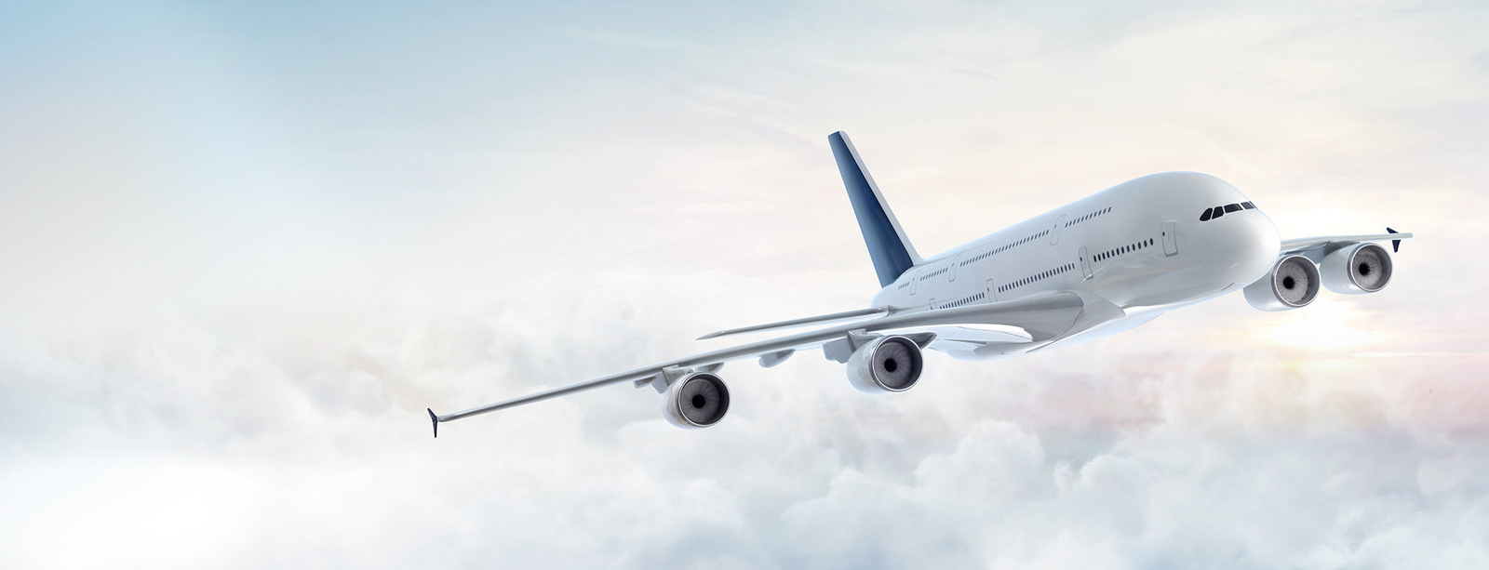
Monetization and Scraping in the Airline industry
How Online Travel Agents and Airlines make money and control scrapers
Muthuraja Palaniappan

Slide 2
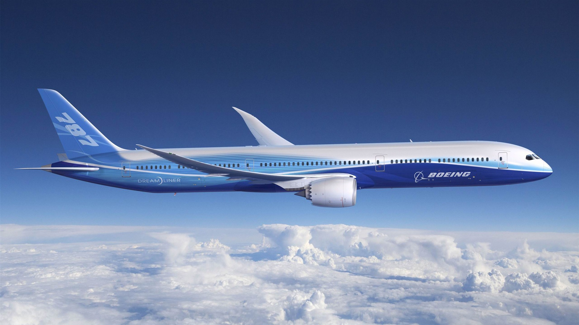
Topic and relevancy
Publicly available data – so what’s wrong in scraping?
Unauthorized access - Risk of going against Terms of Service
How the industry makes money
Direct sales on Airline website
Online Travel Agents (OTAs)
Airline Tariff Publishing Company (ATPCO)
Earn commission
97% of revenues for Priceline (market leader) comes through hotel bookings
All fare details and availability are loaded to ATPCO
Ancillary revenues like hotel bookings
Need not share commission with agents
ATPCO data is then passed on to Global Distribution Systems (GDS) like Sabre
https://www.atpco.net/

Slide 3
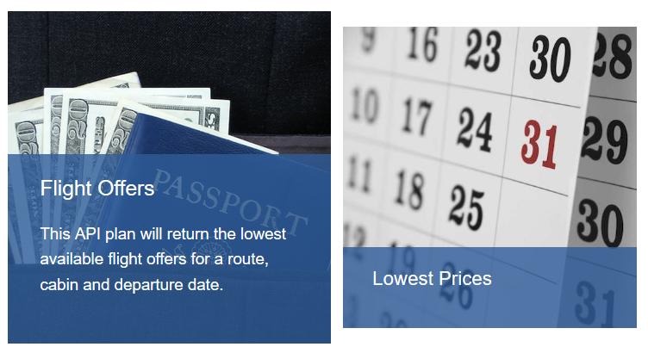
Do the Airlines need to scrape?
All competitors’ current fare details available through Airline Tariff Publishing Company (ATPCO)
So Airlines need not scrape
Do Online Travel Agents (OTAs) need to scrape?
All Airlines have their APIs exposed to OTAs
So no scraping required

Slide 4
Checks and balances
Excessive load on the servers
Measure look-to-book ratio
CAPTCHAs irritate genuine customers but do not deter scrapers
Block IP of scrapers
File lawsuit!

Slide 5
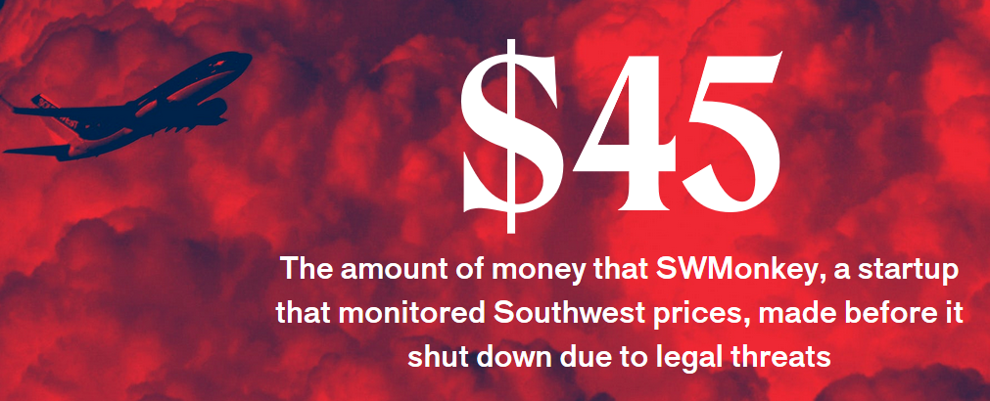

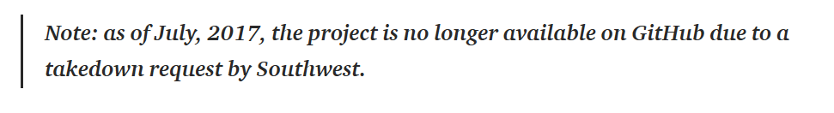
Implications: $45 profit and a lawsuit!
Southwest Airlines – no change fee if you re-book when price changes
SWMonkey : Comparison of Southwest prices to alert customers
No way to earn ancillary revenues
$3 fee for each saving made – is this a sustainable business?
Takedown request given to hacker Zeke Gabrielse

Slide 6
In the near future
Nothing to deter programmers who scrape for personal use
But the moment you make a business out of it, you are in trouble
In the near future, this might continue before Airlines figure out ways to stop this

